Slide 1
BUSINESS PERFORMANCE REPORT
Company: VanArsdel

Slide 2

Summary
Among 9 segments and 212 products available from 2011 to 2016, we should focus on unit price to increase performance
Invest more on Central and West Region
Budget will continue to increase whereas Forecast trend is growing steadily in the future.
Tool Using for Analysis: Excel and Power BI

Slide 3
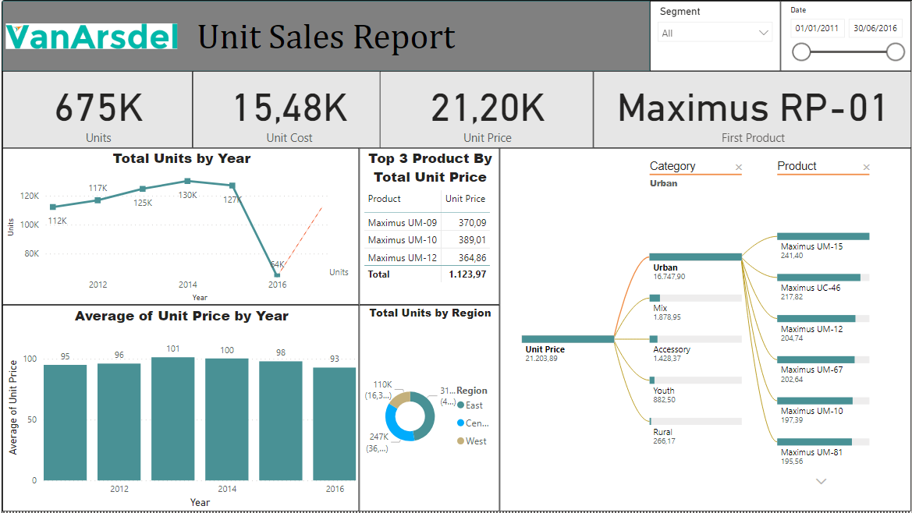
OVERALL REPORT OF UNIT SALES

Slide 4
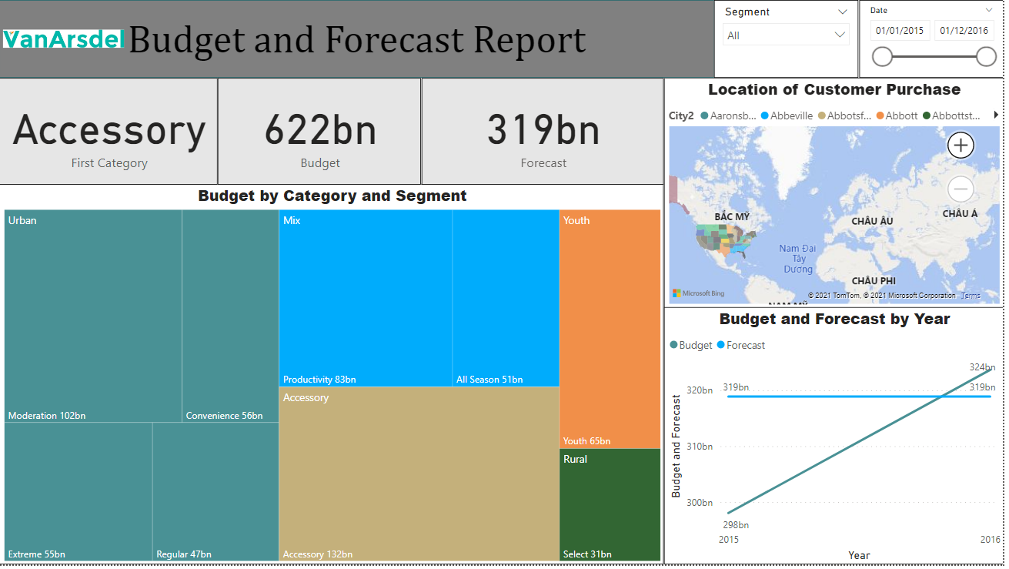
OVERALL REPORT OF BUDGET AND FORECAST

Slide 5

We should focus on unit price to increase performance

Slide 6


Unit Price and Unit Cost has a positive correlation
Unit Price is effective in the long term because coefficient of correlation is 1 (-1<0<1)
Unit price is what is important from the customer’s point of view. On the other hand, unit cost is what holds significance for a manufacturer
The company earns greater profit when the unit price increases, so these two variables are positively correlated.

Slide 7
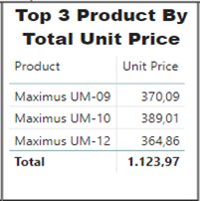
Top 3 Product By Total Unit Price
Maximus UM – 09, Maximus UM – 10 and Maximus – 12 which accounted for around 33% of total Unit Price

Slide 8
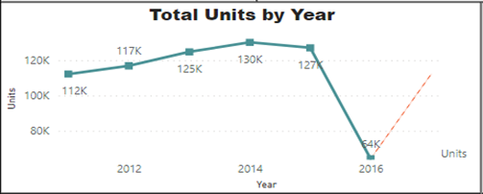
Total Units By Year
Units trended down, resulting in a 42,78% decrease between 2011 and 2016.
Forecast for 2017, the Unit is going to increase values to stable with the market

Slide 9
Invest more on Central and West Region

Slide 10
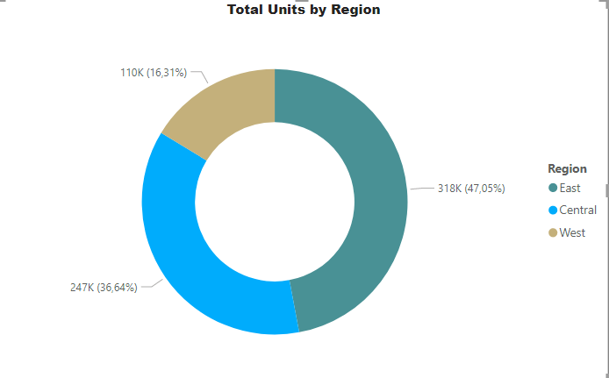
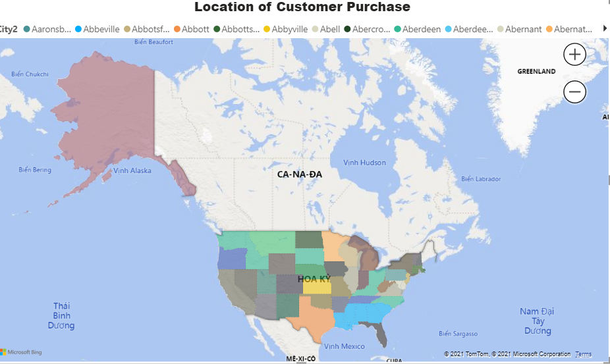
Total Units By Region And Location of Customer Purchase
﻿East had the highest Units at 317704, followed by Central at 247412 and West at 110119.
﻿East accounted for 47,05% of Units.

Slide 11
Budget will continue to increase whereas Forecast trend is growing steadily in the future.

Slide 12
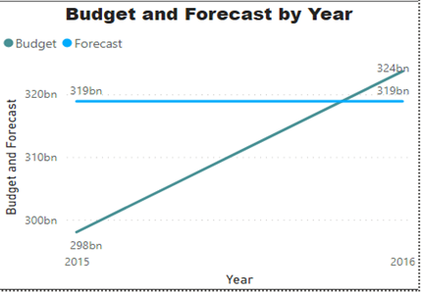
Budget And Forecast By Year
Budget trended up (8,59% increase) while Forecast remained relatively constant between 2015 and 2016.

Slide 13
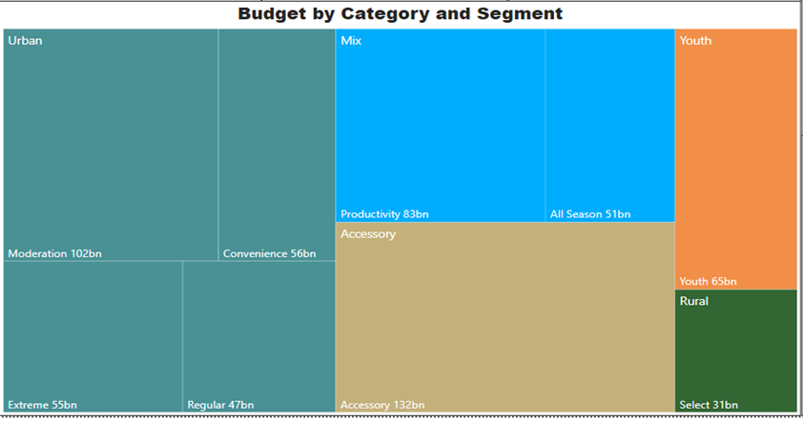
Budget By Category And Segment
Accessory has the largest type of Budget which accounted for 132bn.

Slide 14
RECOMMENDATION

Slide 15


Recommendations
Cost | Recommendation | Pros | Cons
Advertising & Marketing | Re-evaluate the effectiveness of current advertising & marketing strategies to focus on the most effective ones Negotiate with agencies/Find more affordable alternatives with similar quality Conduct market, customer researches and leverage data to understand behavior and trends | Reduce costs on ineffective marketing campaigns Discover insights that helps target customers better | Require training to upskill employees
Others | Leverage cutting-edge technologies (e.g. AI) to predict product demand to free storage and minimize stock damage | Provide regularly accurate prediction of demand to keep the stock loss to minimum level | Require training to upskill employees
Selling & Distribution | Build strong relationships with logistics providers to negotiate and reduce logistics cost Consider switching to other logistics partners if possible Establish optimal travelling routes to save time and cost Consider using more economical vehicles | Lower costs, fuel use and reduce environmental negative impact on air quality. | Switching to new logistics partners may cause unexpected risk
General & Administration | Refer to the record of office item use to observe changes over time and detect unusual changes Search for alternatives of stationery for affordable price and similar quality Leverage technologies and digital tools to reduce the use of physical items (e.g. paper, pens) and travel expenses | Reduce unnecessary items and expenses Save time as procedures are carried out on digital platforms | Require training to upskill employees May cause unexpected risk Low feasibility/Reduce expenses insignificantly

Slide 16
THANK YOU

